Slide 1

Cloud Solution Program CSP
Powering the US Big Bet with Microsoft

Slide 2
What is CSP
The Microsoft CSP program is a way for partners to offer Microsoft cloud products and services, such as Azure, Microsoft 365, and Dynamics 365, to their customers. By becoming a CSP partner, you can:
Create unique solutions for your customers, tailored to their specific needs and goals.
Establish recurring income streams, by providing value-added services and managing the entire customer lifecycle.
Access the latest Microsoft innovations, as well as third-party solutions from the commercial marketplace.
Leverage the Microsoft ecosystem, to get benefits, support, and resources to grow your business.
Own the full customer experience, from billing and invoicing to support and satisfaction.

Slide 3

US Big Bet Target $13.99M
Investment of $2.5m to transform, $2.5 to perform
Target is based on CSP revenue growth in Microsoft FY 25 (July 1)
E5 Revenue sold:$6.59m
Azure ACR Growth:$1.9m
Total of $7.33m ACR
Revenue is CSP only
Any customer type (SMB/SMC/EOU)
Any part of the US

Slide 4
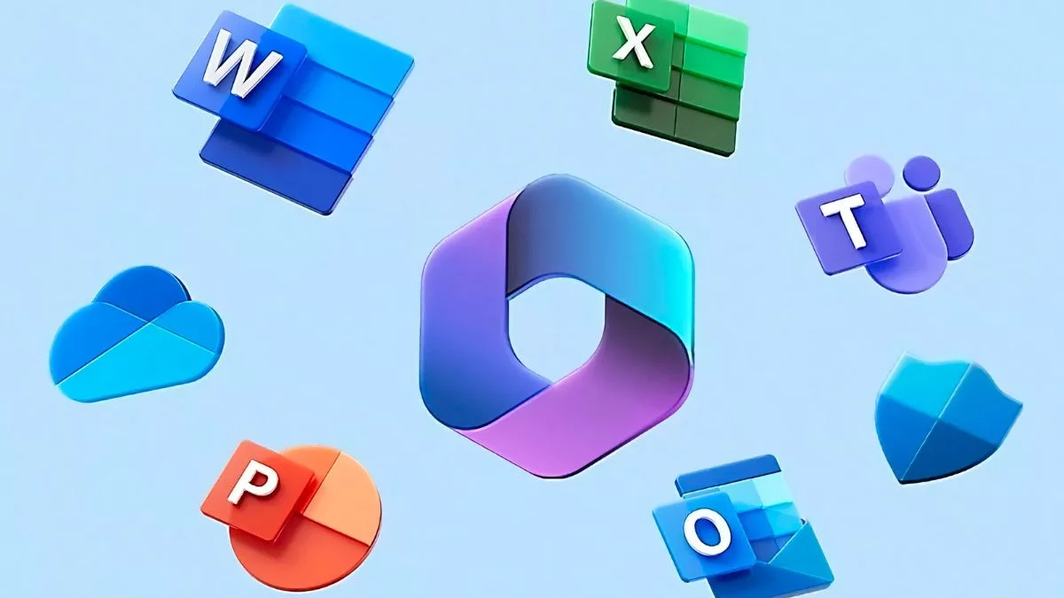
Targets by branch
There are 2 targets E5 revenue and Azure ACR growth
Denver:
E5 Revenue $1.98m
ACR Incremental: $586k
Houston:
E5 Revenue $4.65m
ACR Incremental
$1.37m

Slide 5
Team and Tools to help us get there
It takes a team to wow our clients:
Go To Market Team
Strategic Engagement Team
Practice (SME by solution)
CSP Team
Funding
Account Managers
Customer Data
Existing and Target customers
Marketing
Events (Webinars and in person)
Digital Content
Microsoft Partner Center pipeline sharing *****

Slide 6
CSP Long View Offers
Upfront Annual billing
preapproved discounts to incent customer to pay full 12 months
MXDR Integrated SOS with CSP for Sentinel
5% discount for the Azure consumption for Sentinel
Access to Microsoft Premier Support Service ($45k value)
Azure Health Check
Complimentary assessment for customers who bring over existing Azure to CSP (Q4 Launch)

Slide 7
Key Programs to leverage
AAM (Azure Migrate and Modernize)
Assessment through to Migrations
AIM Business Applications Funding
Presales
Post-sales
CSI Engagements
Security focused paid engagements
Copilot Workshops
Adoption factory
Presales

